Slide 1
__L1n__w@tch
Programming Assignment

Slide 2
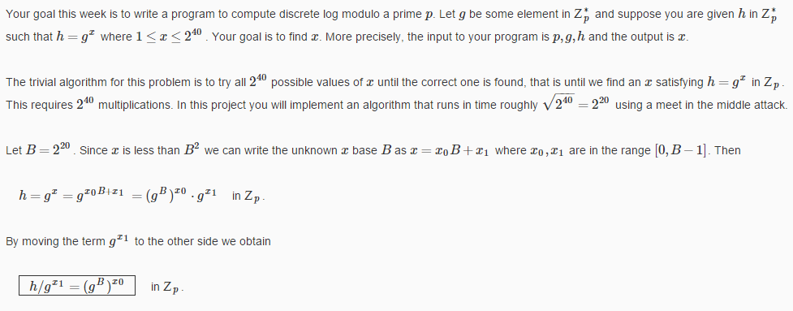
__L1n__w@tch
Question

Slide 3
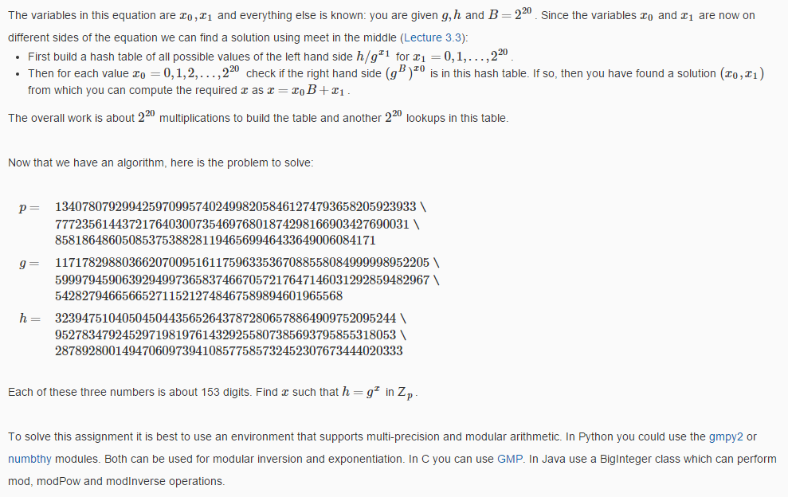
__L1n__w@tch
第一步建个哈希表
第二步哈希查找
Question

Slide 4
__L1n__w@tch
编程

Slide 5
__L1n__w@tch
In the end
T
H
A
N
K
Y
0
U

